Slide 1

STUDENT LOANS
WHAT YOU NEED TO KNOW

Slide 2
WHAT IS A STUDENT LOAN
A loan is money you borrow and must pay back with interest. If you apply for financial aid, you may be offered loans as part of your school’s financial aid offer. When you receive a student loan, you are borrowing money to attend a college or career school. You must repay the loan as well as interest that accrues. It is important to understand your repayment options so you can successfully repay your loan.

Slide 3
WHO IS ELIGIBLE FOR A STUDENT LOAN?
Demonstrate financial need for need-based federal student aid programs;
Be a U.S. Citizen or an eligible noncitizen;
Have a valid social security number (with the exception of students from the republic of the marshall islands, federated states of micronesia, or the republic of palau);
Be enrolled or accepted for enrollment as a regular student in an eligible degree or certificate program;
Maintain satisfactory academic progress in college or career school;
Provide consent and approval to have your federal tax information transferred directly into your free application for federal student aid (FAFSA®) form;
Sign the certification statement on the FAFSA form stating that you’re not in default on a federal student loan, you do not owe money on a federal student grant, and you’ll only use federal student aid for educational purposes; and
Show you’re qualified to obtain a college or career school education.

Slide 4
TYPES OF STUDENT LOANS
Direct subsidized loan
Direct unsubsidized loan
Direct plus loan
Private loan

Slide 5
DIRECT SUBSIDIZED LOAN
Who can get direct subsidized loans?
Direct subsidized loans are available to undergraduate students with financial need.
How much can you borrow?
Your school determines the amount you can borrow, and the amount may not exceed your financial need.
Who will pay the interest?
The U.S. Department of education pays the interest on a direct subsidized loan
While you’re in school at least half-time,
For the first six months after you leave school (referred to as a grace period*), and
During a period of deferment (a postponement of loan payments).
You don’t have to make payments while you are attending at least half time and during your grace period

Slide 6
DIRECT UNSUBSIDIZED LOAN
Who can get direct unsubsidized loans?
Direct unsubsidized loans are available to undergraduate and graduate students; there is no requirement to demonstrate financial need.
How much can you borrow?
Your school determines the amount you can borrow based on your cost of attendance and other financial aid you receive.
Who will pay the interest?
You are responsible for paying the interest on a direct unsubsidized loan during all periods.
You don’t have to make payments while you are attending at least half time and during your grace period

Slide 7
DIRECT PLUS LOAN
The U.S. Department of education is your lender.
You must not have an adverse credit history. A credit check will be conducted. If you have an adverse credit history, you may still be able to receive a PLUS loan if you meet additional requirements.
The maximum plus loan amount you can receive is the cost of attendance (determined by the school) minus any other financial aid received.

Slide 8
PRIVATE LOAN
Private loans are made by private organizations such banks, credit unions, and state-based or state-affiliated organizations, and have terms and conditions that are set by the lender. Private student loans are generally more expensive than federal student loans.
Private student loans often require an established credit record or a cosigner.

Slide 9
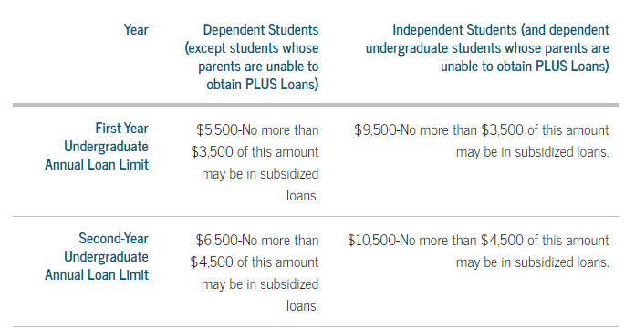
HOW MUCH ARE YOU ELIGIBLE FOR?
There are limits on the amount in subsidized and unsubsidized loans that you may be eligible to receive each academic year (annual loan limits) and the total amounts that you may borrow for undergraduate and graduate study (aggregate loan limits). The actual loan amount you are eligible to receive each academic year may be less than the annual loan limit. These limits vary depending on
What year you are in school and
Whether you are a dependent or independent student.

Slide 10
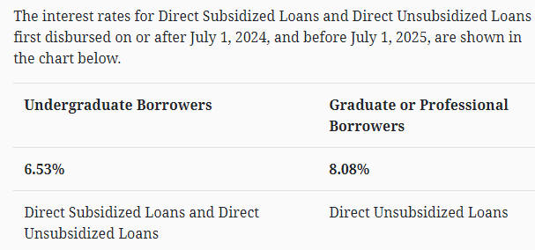
INTEREST RATES

Slide 11
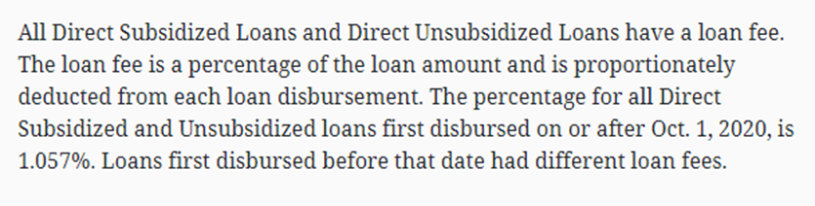
FEES

Slide 12
WHAT CAN YOU USE YOUR STUDENT LOAN FOR?
Tuition
Room
Board
Institutional fees
Books
Supplies
Equipment
Dependent care expenses
Transportation
Commuting expenses
Rental or purchase of a personal computer
Loan fees
Other documented, authorized costs

Slide 13
DIRECT LOAN REQUIREMENTS
Complete entrance counseling at https://studentaid.Gov/entrance-counseling/
Complete master promissory note at https://studentaid.Gov/mpn/
Complete the BRTC loan application https://blackrivertech.Edu/financial-aid/resources/loan-information/
Must be enrolled in a minimum of 6 credit hours
Must be meeting Satisfactory Academic Progress (SAP)

Slide 14
GRACE PERIOD
Begins when you graduate, withdraw, or drop to less than half-time status
You only get one, and it only lasts 6 months.
You will receive your repayment obligation, which includes:
  Date payments are to begin (Payment is expected even if you do not receive a payment booklet or monthly statement.)
  Monthly payment amount
  Repayment terms
  Current principal balance
  Interest rate

Slide 15
BORROWER RESPONSIBILITIES
It is your responsibility to contact your loan servicer and your school if you:
  Change your name, address, or phone number
  Stop attending school or drop below half-time enrollment
  Graduate
  Fail to enroll at the school that determined you were eligible to receive your loan
  Do not enroll at least half time for the loan period certified by your school
  Transfer to another school
You must complete exit counseling when you withdraw, graduate, or drop below half-time attendance (regardless if you plan to transfer to another school), regulations require that you complete an exit counseling session. BRTC will contact you to complete Exit Counseling and will place a hold on your account until it is completed. We will NOT lift the hold until you have complete Exit Counseling.
Also, if you transfer to another school, you may have to redo the counseling for each school. The counseling session provides information about how to manage your student loans after college.
KNOW WHO YOU OWE AND HOW MUCH and Where you are going??

Slide 16
150% TIME LIMIT ON SUBSIDIZED LOANS
Maximum eligibility period to receive Direct Subsidized Loans
There is a limit on the maximum period of time (measured in academic years) that you can receive Direct Subsidized Loans. In general, you may not receive Direct Subsidized Loans for more than 150% of the published length of your program. This is called your “maximum eligibility period”. You can usually find the published length of any program of study in your school’s catalog.
For example, if you are enrolled in a 4-year bachelor’s degree program, the maximum period for which you can receive Direct Subsidized Loans is 6 years (150% of 4 years = 6 years). If you are enrolled in a 2-year associate degree program, the maximum period for which you can receive Direct Subsidized Loans is 3 years (150% of 2 years = 3 years).
Your maximum eligibility period is based on the published length of your current program. This means that your maximum eligibility period can change if you change programs. Also, if you receive Direct Subsidized Loans for one program and then change to another program, the Direct Subsidized Loans you received for the earlier program will generally count against your new maximum eligibility period.
  Here is an example of how your maximum eligibility period can change if you change programs.
  You are enrolled in a two-year undergraduate program. You then enroll in a four-year undergraduate
  program. When you change programs, your maximum eligibility changes from three years to six years.
  You received Direct Subsidized Loans for only one year while enrolled in the two-year program. (You
  would have been eligible to receive two more years of Direct Subsidized Loans if you had stayed in that
  program.)
  When you enroll in the four-year program, you are eligible to receive five more years of Direct Subsidized Loans.

Slide 17
FEDERAL PELL GRANT LIFETIME ELIGIBILITY USED (LEU)
The amount of federal pell grant funds you may receive over your lifetime is limited by federal law to be the equivalent of six years of pell grant funding. Since the amount of a scheduled Pell grant award you can receive each award year is equal to 100%, the six-year equivalent is 600%.
The maximum amount of federal Pell grant funding you can receive is calculated for an award year. An award year is a period from July 1 of one calendar year to June 30 of the next calendar year.
Your scheduled award
  Is partially determined by using either your expected family contribution (EFC) for the 2034-24 FAFSA form, or your student aid index (SAI) for the 2024-25 FAFSA form;
  Is the maximum amount you would be able to receive for the award year if you were enrolled full-time for the full school year; and
  Represents 100% of your Pell grant eligibility for that award year.
Percent used: to determine how much of the maximum six years (600%) of Pell grant you have used each year, the U.S. Department of education (ED) compares the actual amount you received for the award year with your scheduled award amount for that award year.

Slide 18
THINGS THAT CAN AFFECT YOUR ELIGIBILITY
Completed Financial Aid file- Do the FAFSA application at www.studentaid.gov
Submitting ALL required documents to BRTC Financial Aid Office.
  Financial Aid Office will notify you by mail/email of missing documents, you must submit them to us before your aid will be processed. This may also be viewed on myBRTC portal through the Self-service option My Financial Aid
Previous attendance at other institutions-
    Must have ALL official transcripts from previously attended schools before Financial Aid awards will be approved
  Satisfactory Academic Progress-(SAP) -- maintaining a 2.00 GPA and 67% PACE per term & cumulative https://blackrivertech.edu/financial-aid/resources/
Maximum eligibility limits for Pell and Loans – on the Loan Application

Slide 19
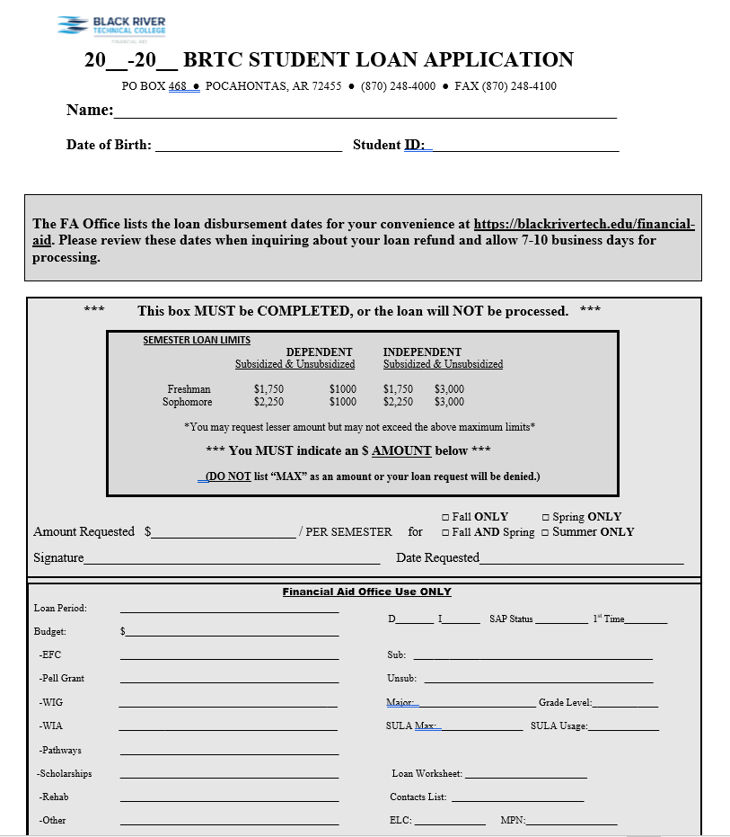
HOW TO REQUEST A LOAN AT BRTC
You must complete the BRTC loan application and return it to the Financial Aid Office with the following:
  Contact List
  Direct Loan Worksheet plus required printouts
  Entrance Counseling (online)
  Master Promissory Note (online)

Slide 20
DISBURSEMENT DATES
BRTC will first apply your loan funds to your school account to pay for tuition, fees, room and board, and other school charges. If any additional loan funds remain, we will issue a refund to you. All loan funds must be used for your education expenses.
ALL student loans will be made in multiple disbursements each semester -
2 equal disb’s for Fall
2 equal disb’s for Spring
2 equal disb’s for Summer (1 in Summer I /1 in Summer II)
*** Disbursement Date Schedules are always posted on the FA page of BRTC website https://blackrivertech.edu/financial-aid/ ***
Will not get full amount all at once unless you missed the original disbursement date.
Loans and Pell are based on ATTENDANCE. If you do not attend, you will not earn the funds.
If you take the funds and did not earn them…….you will owe a bill with BRTC and/or the Federal Government. You must complete 60% of the semester to earn the federal funds.

Slide 21
REPAYMENT
You can pick from repayment plans that base your monthly payment on your income or plans that give you a fixed monthly payment.
Repayment plans based on your income are a smart choice to lower your payment. For example, payments on the saving on a valuable education (SAVE) plan are no more than 10% of your discretionary income. The lower your income—or the larger your family size—the less you’ll pay each month.
If you don’t pick a repayment plan, your loan servicer will place you on the standard repayment plan (a 10-year fixed payment repayment plan). This plan might result in a higher monthly payment for you.

Slide 22
INCOME-DRIVEN REPAYMENT PLANS (IDR)
IDR plans base your monthly payment amount on how much money you make and your family size. We offer four IDR plans:
Saving on a valuable education (SAVE) plan—formerly the REPAYE plan
Pay as you earn (PAYE) repayment plan
Income-based repayment (IBR) plan
Income-contingent repayment (ICR) plan

Slide 23
STUDENT LOAN FORGIVENESS
Loan Forgiveness Programs
  Loan forgiveness programs promote employment in certain fields by forgiving part or all of you loan debts, provided you fulfill certain work-related requirements.
Federal Loan Forgiveness Programs
  Teacher Loan Forgiveness Program – 5 years - $5,000 or $17,500
  Public Service Loan Forgiveness Program – 10 years – remaining principal & interest
  Federal Employee Student Loan – Minimum 3 years required service – up to $10,000 annually – up to $60,000 maximum
State loan forgiveness programs vary. Please check with the individual state.
*** For Arkansas residents, you may go to ADHE.edu and inquire the detail of a loan
forgiveness program.

Slide 24
WHAT IS DELINQUENCY
Delinquency
  Failing to make your scheduled monthly loan payments will negatively affect your credit.
  Late payments stay on your credit history for 7 years.
  Your lender, loan servicer, and school will begin contacting you via letters and phone calls, which will continue until you resolve the delinquency.

Slide 25
WHAT IS DEFAULT?
Default
If a loan remains delinquent, you will default. If you default, the entire unpaid balance and any accrued collection fees on the applicable loans will become immediately due and payable.
Consequences of default may include any or all of the following:
  Damage to your credit rating
  Garnishment of your wages
  Legal action against you
  Collection charges (including attorney fees) being assessed against you
  Loss of deferment eligibility
  Loss of your professional license
  An increase in the interest rate on your loan
  Withholding of your federal and state income tax refunds
  Loss of eligibility for state and federal financial aid
  Loss of other state or federal payments

Slide 26

CAN’T MAKE YOUR PAYMENT?
If you're having trouble making payments on your loans, contact your loan servicer or your school loan advisors as soon as possible to discuss options that may help you.
Options include:
  Changing repayment plans
  Deferment, if you meet certain requirements (for example, if you are unable to find full-time employment, or are experiencing an economic hardship). A deferment allows you to temporarily stop making payments on your loan.
  Forbearance, if you don't meet the eligibility requirements for a deferment but are temporarily unable to make your loan payments. Forbearance allows you to temporarily stop making payments on your loan, temporarily make smaller payments, or extend the time for making payments.
If you stop making payments and don't get a deferment or forbearance, your loan could go into default, which has serious consequences!
You must be aware that a deferment or forbearance is for a limited time, and it must be renewed if eligible.

Slide 27
BUDGET ALLOCATION OF AWARDS
Cost of Attendance Budget determines your loan amount available. Your TOTAL aid package may not exceed your
cost of attendance.
  Example:
  $6, 800 budget for each semester - Fall/Spring
  -$3,698 Pell for full time status/semester (if qualified for maximum Pell award)
  -$1,000 AR Challenge Scholarship each term
  -$2,250 Sub loan each term (sophomore level loan)
  $148 Unsub loan each term
  $ 0 need remaining
Any scholarships or other aid received will cause your loan to be reduced!

Slide 28
DEFERMENT & FORBEARANCE
Types of Deferment
Types of forbearance
In-School
Graduate Fellowship
Rehabilitation Training Program
Unemployment
Economic Hardship
Military
Discretionary Forbearance
For discretionary forbearances, your lender decides whether to grant forbearance or not.
You can request a discretionary forbearance for the following reasons:
Financial hardship
Illness

Slide 29
FINANCIAL LITERACY
Make sure you have applied for all types of aid before requesting a student loan. i.e. Pell, scholarships, work study, other programs such as Pathways and WIOA.
Prepare yourself for repayment!
Start making a habit of good finances now by making better financial decisions regarding your student loans.
  Set a budget and stick to it.
  Plan your educational goals and be looking at what your total student loans may be when completed.
  Do not get loans just to support you and your family!
  KNOW WHAT YOU ARE DOING HERE AND PLANS FOR FUTURE
  KNOW WHO YOU OWE AND HOW MUCH!!

Slide 30
FINANCIAL RESOURCES
FAFSA AT HTTPS://STUDENTAID.GOV/
STATE SCHOLARSHIPS AT HTTPS://ADHE.EDU/
BRTC SCHOLARSHIPS AT HTTPS://BLACKRIVERTECH.EDU/FINANCIAL-AID/SCHOLARSHIP-OPPORTUNTIES/
WORK STUDY AT HTTPS://BLACKRIVERTECH.EDU/FINANCIAL-AID/RESOURCES/FEDERAL-WORK-STUDY/
ARKANSAS SINGLE PARENT SCHOLARSHIP AT HTTPS://WWW.ASPSF.ORG/COUNTY-MAP
PATHWAYS FUNDING AT HTTPS://BLACKRIVERTECH.EDU/FINANCIAL-AID/CAREER-PATHWAYS/
VETERAN BENEFITS AT HTTPS://BLACKRIVERTECH.EDU/STUDENTS/VETERAN-AFFAIRS/
WIOA AT HTTPS://WWW.NEAWORKS.COM/

Slide 31

HAVE QUESTIONS ABOUT YOUR LOANS?
Contact the BRTC Financial Aid office for any questions regarding your financial aid @ (870)248-4000
POCAHONTAS CAMPUS
Brandi Chester; Director of Financial Aid, Ext. 4020 Brandic@blackrivertech.Edu
Ashley Conrey; Assistant Director of Financial Aid, Ext. 4019 Ashley.conrey@blackrivertech.edu
PARAGOULD CAMPUS
Eugenia Riney; Financial Aid Advisor, Ext. 5016 Eugenia.riney@blackrivertech.edu

